Slide 1
Bank-as-a-Service(Baas) Risk Monitoring
Week progress: Data cleaning and EDA
Delphin | Solomon | Tycho
The Catholic University of America
Capstone Project
Fall 2025

Slide 2
Problem Definition
Growth of digital transactions in BaaS, increases exposure to fraud.
Fraudulent activities cause financial losses, reputational damage, and loss of customer trust.(Synapse collapse in 2024).
BaaS platforms need real-time monitoring to serve Fintech partners.
Current systems struggle with accuracy, with high False positive (legitimate flagged) and high False Negative(Fraud Missed).

Slide 3
Data overview
Dataset Source: IBM Synthetic data for core banking and money laundering.
Loaded: 31+M Entries, 11 columns
Initial checks: dtypes, shape, missing values
Found:
  Timestamp as object → needs conversion
  Accounts: IDs, should remain strings
  Amounts: long-tail distribution with extreme outliers

Slide 4
Schema Fixes
Converted Timestamp → datetime
Converted Payment/Receiving Currency & Payment Format → categorical
Memory usage reduced: 2.6 GB → 2.0 GB
Accounts retained as string IDs

Slide 5
Duplicates & Integrity
Convert Timestamp → datetime
Converted Payment/Receiving Currency & Payment Format →
Found: 20 exact duplicate rows → dropped
Verified Account & Bank ID consistency
Duplicates not laundering signals → safe to remove

Slide 6
Research Questions Answered in EDA
Which payment formats are riskier?
ACH has the highest laundering rate (0.79%).Bitcoin, Cash have moderate rates.Credit Card & Cheque show very low laundering rates.
Which currencies show higher laundering rates?
GBP, Ruble, Euro have the highest laundering percentages.USD also notable given large transaction volume.
Do time patterns matter?
Yes. Laundering attempts cluster in business hours (10AM–3PM). Daily laundering rate spikes after Sept 15 (likely data artifact → must be treated carefully).
Are numeric features (amounts, bank IDs) directly correlated with laundering?
No. Correlations with Is Laundering are near zero.Stronger predictors are categorical + temporal features.
Is the dataset complete and usable?
Yes. No missing values in key fields, no negative or zero amounts. Dataset is consistent and schema-correct.
Are there duplicate or invalid transactions?
Found 20 exact duplicates (not laundering) → dropped safely. Accounts and banks are valid; self-transfers flagged for later analysis.
What is the distribution of the target variable (Is Laundering)?
Extremely imbalanced → only 0.11% laundering cases.
Accuracy alone is our not a reliable metric, Recall and Precise our metrics to focus on.
How are transaction amounts distributed?
Strong long-tail distribution.Most amounts are small; a few extreme outliers → log-transformation needed.

Slide 7
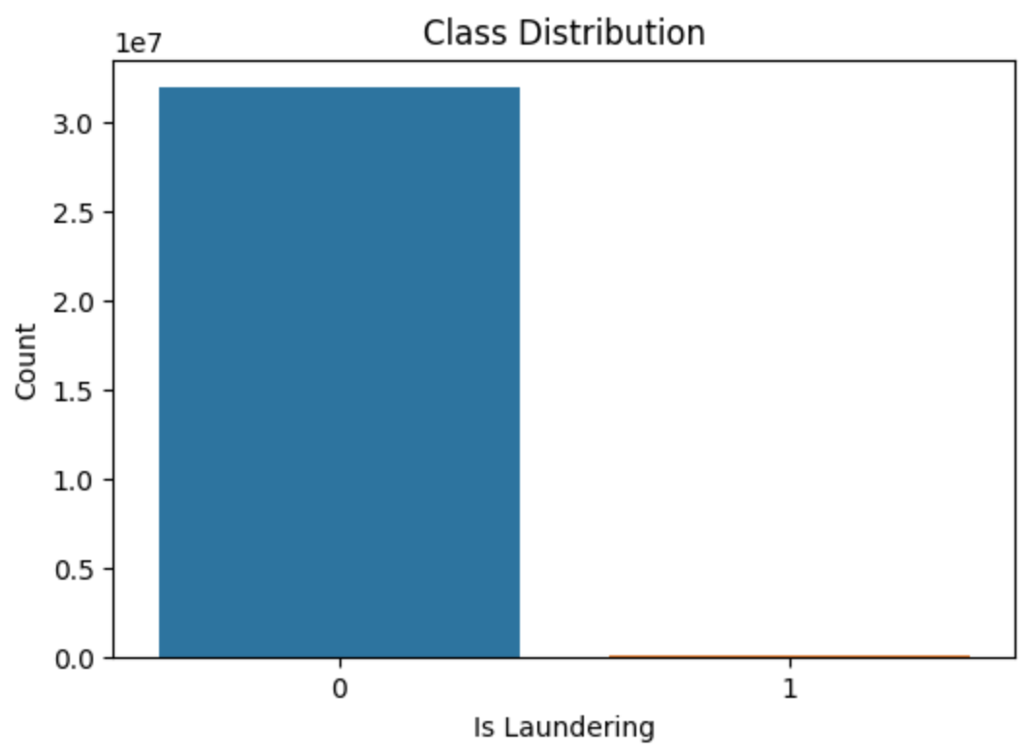
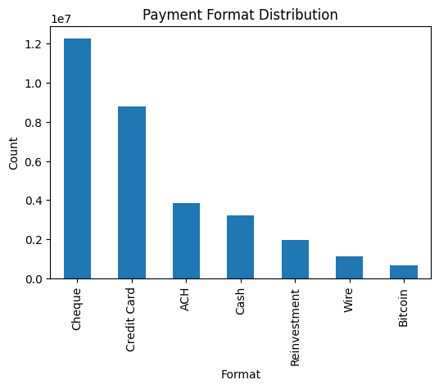
EDA Highlights
Target imbalance: 0.11% laundering vs 99.89% non-laundering
Amounts: long-tail → log-transform required
Payment Format: ACH has the highest laundering rate (0.79%)
Currency: GBP, Ruble, Euro show top laundering rates

Slide 8
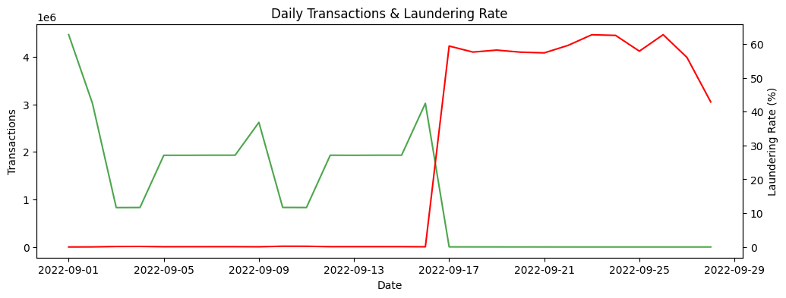
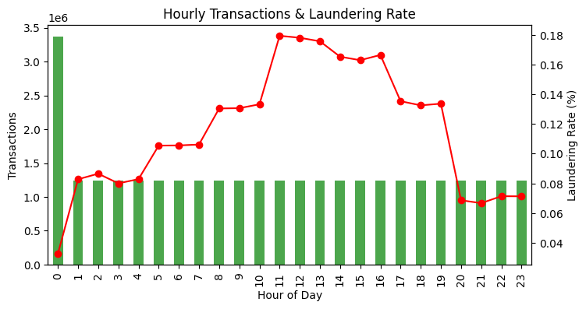
EDA Highlights
Time patterns: laundering peaks during 10AM- 3PM business hours and Laundering rate (%) spikes after Sep 16,

Slide 9
Conclusion and Preprocessing Plan
Conclusion: The insights from EDA
Dataset is: clean, consistent, and schema-correct
Strong predictors noted: Payment Format, Currency, Time features
Numeric features alone show weak correlation with laundering
Preprocessing Plan:We’ll prepare the dataset for modeling:
scale/log-transform amounts
encode categorical features (currencies, formats)
add temporal features (hour, weekday, weekend flag)
handle class imbalance (Undersampling).

Slide 10
Thank you

